Slide 1
CLASS 30 CD-502 Data Pre-Processing UNIT 1
Data Pre-Processing
Prof. Vineeta Shrivastava
Assistant Professor
Department of Computer Science & Engineering
LNCT-E, Bhopal
Lakshmi Narain College of Technology Excellence, Bhopal

Slide 2
CLASS 30 CD-502 Data Pre-Processing UNIT 1
AGENDA
Data Preprocessing: An Overview
Data Quality
Major Tasks in Data Preprocessing
Data Cleaning
Data Integration
Data Reduction
Data Transformation and Data Discretization
Prof. Vineeta Shrivastava
Assistant Professor
Department of Computer Science & Engineering
LNCT-E, Bhopal
Lakshmi Narain College of Technology Excellence, Bhopal

Slide 3
CLASS 30 CD-502 Data Pre-Processing UNIT 1
Data Pre-processing: An Overview
What is data pre-processing ??
Data
Audio
Text
Video
Image
Data Pre-processing is a technique to convert raw data into meaning full data by using some different techniques.
Why Data Pre-processing is important?
Data in real world is dirty.
Incomplete
Inconsistent
Noisy
Duplicate
Prof. Vineeta Shrivastava
Assistant Professor
Department of Computer Science & Engineering
LNCT-E, Bhopal
Lakshmi Narain College of Technology Excellence, Bhopal

Slide 4
CLASS 30 CD-502 Data Pre-Processing UNIT 1
Data Pre-processing for ML
Data pre-processing is the processing of preparing the data and making it suitable for a ML model.
A quality of data affects the ability of model to learn , hence it is extremely important that we process data before giving as input to model.
Prof. Vineeta Shrivastava
Assistant Professor
Department of Computer Science & Engineering
LNCT-E, Bhopal
Lakshmi Narain College of Technology Excellence, Bhopal

Slide 5
CLASS 30 CD-502 Data Pre-Processing UNIT 1
Data Pre-processing for ML
Whenever data is generated from different sources it is collected in raw format which is not suitable for analysis. So data pre-processing is a technique that is used to convert the raw data into a clean dataset.
Data in raw format contains noises, missing values, not in usable format.
Data pre-processing cleans the data and make it suitable for ML model which also increases the accuracy and efficiency of a ML model.
Prof. Vineeta Shrivastava
Assistant Professor
Department of Computer Science & Engineering
LNCT-E, Bhopal
Lakshmi Narain College of Technology Excellence, Bhopal

Slide 6
CLASS 30 CD-502 Data Pre-Processing UNIT 1
Data Quality: Why Preprocess the Data?
Measures for data quality: A multidimensional view
Accuracy:
Completeness:
Consistency:
Timeliness:
Believability:
Interpretability:
Prof. Vineeta Shrivastava
Assistant Professor
Department of Computer Science & Engineering
LNCT-E, Bhopal
Lakshmi Narain College of Technology Excellence, Bhopal

Slide 7
CLASS 30 CD-502 Data Pre-Processing UNIT 1
Major Tasks in Data Preprocessing
Data collection
Collect data from different sources
Data cleaning
Fill in missing values, smooth noisy data, identify or remove outliers, and resolve inconsistencies
Data integration
Integration of multiple databases or files
Data reduction
Dimensionality reduction
Data compression
Data transformation and data discretization
Normalization
Concept hierarchy generation
Prof. Vineeta Shrivastava
Assistant Professor
Department of Computer Science & Engineering
LNCT-E, Bhopal
Lakshmi Narain College of Technology Excellence, Bhopal

Slide 8
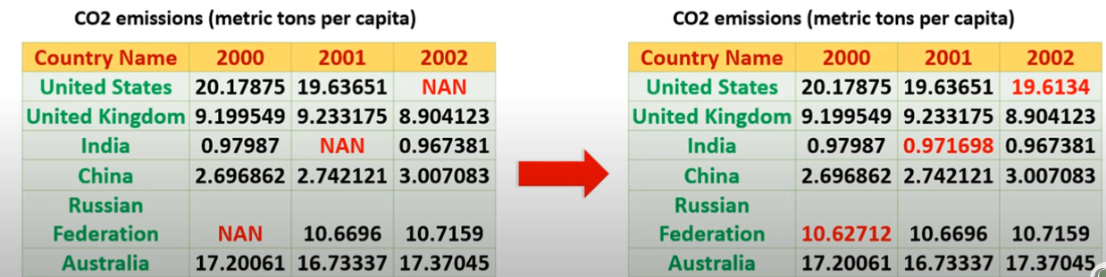
CLASS 30 CD-502 Data Pre-Processing UNIT 1
What is data cleaning?
Data cleaning means fill in missing values, smooth out noise while identifying outliers and correct inconsistency in data.
Prof. Vineeta Shrivastava
Assistant Professor
Department of Computer Science & Engineering
LNCT-E, Bhopal
Lakshmi Narain College of Technology Excellence, Bhopal

Slide 9
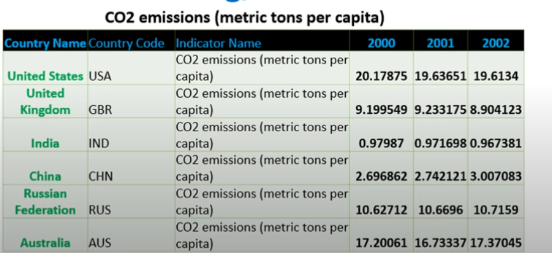
CLASS 30 CD-502 Data Pre-Processing UNIT 1
What is data integration ?
Data integration is a technique to merges data from multiple sources into a coherent data store, such as data warehousing.
Prof. Vineeta Shrivastava
Assistant Professor
Department of Computer Science & Engineering
LNCT-E, Bhopal
Lakshmi Narain College of Technology Excellence, Bhopal

Slide 10
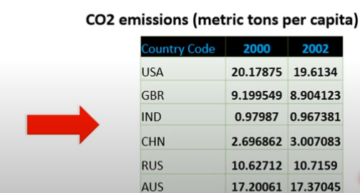
CLASS 30 CD-502 Data Pre-Processing UNIT 1
What is data Reduction ?
Data reduction is a technique to reduce the data size by aggregating, eliminating redundant features, or clustering.
Prof. Vineeta Shrivastava
Assistant Professor
Department of Computer Science & Engineering
LNCT-E, Bhopal
Lakshmi Narain College of Technology Excellence, Bhopal

Slide 11
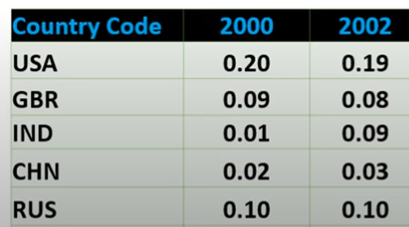
CLASS 30 CD-502 Data Pre-Processing UNIT 1
What is data transformation?
Data transformation means data are transformed or consolidated into forms appropriate for ML model training, such as normalization, may be applied where data are scaled to fall with in a smaller range like 0.0 and 1.0
Aggregation
Feature type conversion
Normalization
Attribute/feature construction.
Prof. Vineeta Shrivastava
Assistant Professor
Department of Computer Science & Engineering
LNCT-E, Bhopal
Lakshmi Narain College of Technology Excellence, Bhopal

Slide 12
CLASS 30 CD-502 Data Pre-Processing UNIT 1
What is data discretization?
Data discretization technique transforms the numeric data by mapping values to interval or concept labels.
It can be used to reduce the number of values for a given continuous attribute by dividing the range of attributes into intervals.
Data discretization technique include-
Histogram analysis
Cluster analysis
Decision tree analysis
Correlation analysis
Prof. Vineeta Shrivastava
Assistant Professor
Department of Computer Science & Engineering
LNCT-E, Bhopal
Lakshmi Narain College of Technology Excellence, Bhopal

Slide 13
CLASS 30 CD-502 Data Pre-Processing UNIT 1
Step 1:Data Collection
This step involves gathering data from various sources such as databases, files and external repositories. Before starting the data collection process, first we have to find out the problem solved by ML model.
Knowing the objective to achieve by algorithm will assist in determining the type of data required.
Also it helps in getting a clear picture of all data available, required and missing.
Prof. Vineeta Shrivastava
Assistant Professor
Department of Computer Science & Engineering
LNCT-E, Bhopal
Lakshmi Narain College of Technology Excellence, Bhopal

Slide 14
CLASS 30 CD-502 Data Pre-Processing UNIT 1
The process of gathering and analyzing accurate data from various sources to find answers to research problems, trends and probabilities, etc., to evaluate possible outcomes is Known as Data Collection.
Data collection is the process of collecting and evaluating information or data from multiple sources to find answers to research problems, answer questions, evaluate outcomes, and forecast trends and probabilities.
Prof. Vineeta Shrivastava
Assistant Professor
Department of Computer Science & Engineering
LNCT-E, Bhopal
Lakshmi Narain College of Technology Excellence, Bhopal

Slide 15
CLASS 30 CD-502 Data Pre-Processing UNIT 1
Before an analyst begins collecting data, they must answer three questions first:
What’s the goal or purpose of this research?
What kinds of data are they planning on gathering?
What methods and procedures will be used to collect, store, and process the information?
Prof. Vineeta Shrivastava
Assistant Professor
Department of Computer Science & Engineering
LNCT-E, Bhopal
Lakshmi Narain College of Technology Excellence, Bhopal

Slide 16
CLASS 30 CD-502 Data Pre-Processing UNIT 1
Different Data Collection Methods
Primary and secondary methods of data collection are two approaches used to gather information for research or analysis purposes.
Primary data collection involves the collection of original data directly from the source or through direct interaction with the respondents.
Prof. Vineeta Shrivastava
Assistant Professor
Department of Computer Science & Engineering
LNCT-E, Bhopal
Lakshmi Narain College of Technology Excellence, Bhopal

Slide 17
CLASS 30 CD-502 Data Pre-Processing UNIT 1
Various techniques for primary data collection, including:
Surveys and Questionnaires
Interviews
Observations
Experiments
Focus Groups
Prof. Vineeta Shrivastava
Assistant Professor
Department of Computer Science & Engineering
LNCT-E, Bhopal
Lakshmi Narain College of Technology Excellence, Bhopal

Slide 18
CLASS 30 CD-502 Data Pre-Processing UNIT 1
Secondary Data Collection:
Secondary data collection involves using existing data collected by someone else for a purpose different from the original intent.
Researchers analyze and interpret this data to extract relevant information.
Prof. Vineeta Shrivastava
Assistant Professor
Department of Computer Science & Engineering
LNCT-E, Bhopal
Lakshmi Narain College of Technology Excellence, Bhopal

Slide 19
CLASS 30 CD-502 Data Pre-Processing UNIT 1
Secondary data can be obtained from various sources, including:
Published Sources
Online Databases:
Government and Institutional Records
Publicly Available Data
Past Research Studies
Prof. Vineeta Shrivastava
Assistant Professor
Department of Computer Science & Engineering
LNCT-E, Bhopal
Lakshmi Narain College of Technology Excellence, Bhopal

Slide 20
CLASS 30 CD-502 Data Pre-Processing UNIT 1
Data Collection Tools
Social Media Listening Tool (hootshoot and sprout)
Web Analytics Tools
Data Logging Devices
Mobile Data Collection Apps
IoT Platforms
Prof. Vineeta Shrivastava
Assistant Professor
Department of Computer Science & Engineering
LNCT-E, Bhopal
Lakshmi Narain College of Technology Excellence, Bhopal

Slide 21
CLASS 30 CD-502 Data Pre-Processing UNIT 1
Data Augmentation (A method of data collection)
In some cases, data augmentation might be required to expand the size of existing dataset without gathering more data.
If we have more data, the better will be our ML model. But every data collection process is associated with a cost.
This cost may be in terms of dollars, human efforts, computational resources and time consumed in the process.
Therefore we may need to augment existing data to increase the data size that we feed to our ML model.
Prof. Vineeta Shrivastava
Assistant Professor
Department of Computer Science & Engineering
LNCT-E, Bhopal
Lakshmi Narain College of Technology Excellence, Bhopal

Slide 22
CLASS 30 CD-502 Data Pre-Processing UNIT 1
Data Augmentation (A method of data collection)
For example if a dataset of images are collected they can be augmented by
Rotating the original image
Crop the original image differently
Altering the light condition
So for one image you can generate different sub samples
Prof. Vineeta Shrivastava
Assistant Professor
Department of Computer Science & Engineering
LNCT-E, Bhopal
Lakshmi Narain College of Technology Excellence, Bhopal

Slide 23
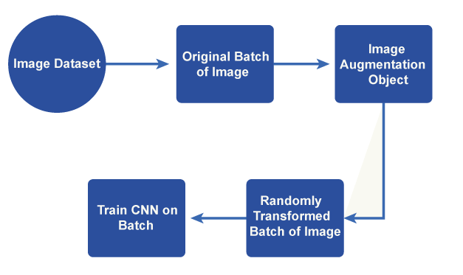
CLASS 30 CD-502 Data Pre-Processing UNIT 1
Fig 1: data augmentation
Prof. Vineeta Shrivastava
Assistant Professor
Department of Computer Science & Engineering
LNCT-E, Bhopal
Lakshmi Narain College of Technology Excellence, Bhopal

Slide 24
CLASS 30 CD-502 Data Pre-Processing UNIT 1
Techniques for data augmentation can be used with a variety of data, including time series, text, photos, and audio.
Images can be rotated at different angles and flipped horizontally or vertically to create alternative points of view.
Random cropping and padding
Scaling and zooming
Shearing and perspective transform
Colour segmentation
Gaussian noise
Prof. Vineeta Shrivastava
Assistant Professor
Department of Computer Science & Engineering
LNCT-E, Bhopal
Lakshmi Narain College of Technology Excellence, Bhopal

Slide 25
CLASS 30 CD-502 Data Pre-Processing UNIT 1
Types of Data Augmentations
Real Data Augmentation
Synthetic Data Augmentation
Prof. Vineeta Shrivastava
Assistant Professor
Department of Computer Science & Engineering
LNCT-E, Bhopal
Lakshmi Narain College of Technology Excellence, Bhopal

Slide 26
CLASS 30 CD-502 Data Pre-Processing UNIT 1
Real Data Augmentation
The process of modifying real-world data samples to enhance the base of training for artificial intelligence models is referred to as "real data augmentation."
Real data augmentation, as compared to synthetic data augmentation produces new samples based on existing data and also modifies the original data in a way that accurately removes fluctuations and disturbances that occur in the real world.
Prof. Vineeta Shrivastava
Assistant Professor
Department of Computer Science & Engineering
LNCT-E, Bhopal
Lakshmi Narain College of Technology Excellence, Bhopal

Slide 27
CLASS 30 CD-502 Data Pre-Processing UNIT 1
Real Data augmentation approaches as examples:
Sensor noise
Occlusion
Weather
Time series
Label smoothing
Prof. Vineeta Shrivastava
Assistant Professor
Department of Computer Science & Engineering
LNCT-E, Bhopal
Lakshmi Narain College of Technology Excellence, Bhopal

Slide 28
CLASS 30 CD-502 Data Pre-Processing UNIT 1
Synthetic Data Augmentation
In machine learning, synthetic data augmentation creates additional artificial data samples based on current data to increase the training set.
It is a method for broadening the variety and volume of data accessible for model training.
When a dataset is not in large quantity or more variations are required to boost a model's performance, synthetic data augmentation can be especially helpful.
Prof. Vineeta Shrivastava
Assistant Professor
Department of Computer Science & Engineering
LNCT-E, Bhopal
Lakshmi Narain College of Technology Excellence, Bhopal

Slide 29
CLASS 30 CD-502 Data Pre-Processing UNIT 1
Synthetic Data augmentation approaches as examples
Image synthesis
Text generation
Oversampling and undersampling
Data interpolation and extrapolation
Feature perturbation
Prof. Vineeta Shrivastava
Assistant Professor
Department of Computer Science & Engineering
LNCT-E, Bhopal
Lakshmi Narain College of Technology Excellence, Bhopal

Slide 30
CLASS 30 CD-502 Data Pre-Processing UNIT 1
Challenges Faced by Data Augmentation
Maintaining label integrity
Excessive or incorrect data augmentation can result in overfitting
Data augmentation can dramatically increase the size of the training dataset
Data security and privacy
Interpretability and explain ability
Prof. Vineeta Shrivastava
Assistant Professor
Department of Computer Science & Engineering
LNCT-E, Bhopal
Lakshmi Narain College of Technology Excellence, Bhopal

Slide 31
CLASS 30 CD-502 Data Pre-Processing UNIT 1
Data Labelling
Data labelling in supervised ML models, might be also a part of data preparation process.
It can be done manually by crowd workers or automatically using specialized framework.
Data pre-processing
As the data collected in steps1 may be in undesired format, unorganized or extremely large so further steps are needed to enhance the quality of data.
Prof. Vineeta Shrivastava
Assistant Professor
Department of Computer Science & Engineering
LNCT-E, Bhopal
Lakshmi Narain College of Technology Excellence, Bhopal

Slide 32
CLASS 30 CD-502 Data Pre-Processing UNIT 1
Data Labelling
Data labeling is the way of identifying the raw data and adding suitable labels or tags to that data to specify what this data is about, which allows ML models to make an accurate prediction.
Prof. Vineeta Shrivastava
Assistant Professor
Department of Computer Science & Engineering
LNCT-E, Bhopal
Lakshmi Narain College of Technology Excellence, Bhopal

Slide 33
CLASS 30 CD-502 Data Pre-Processing UNIT 1
Labeled Data vs. Unlabelled Data
Labeled data is data that has some predefined tags such as name, type, or number. For example, an image has an apple or banana. At the same time, unlabelled data contains no tags or no specified name.
Labeled data is used in Supervised Learning techniques, whereas Unlabelled data is used in Unsupervised Learning.
Labeled data is difficult to get, whereas Unalabled data is easy to acquire.
Prof. Vineeta Shrivastava
Assistant Professor
Department of Computer Science & Engineering
LNCT-E, Bhopal
Lakshmi Narain College of Technology Excellence, Bhopal

Slide 34
CLASS 30 CD-502 Data Pre-Processing UNIT 1
Tools for Data Labelling
Super Annotate
Encord
Kili
Appen
Dataloop
Labellers
Scale Rapid
Ango hub
Trainingdat.io
Prof. Vineeta Shrivastava
Assistant Professor
Department of Computer Science & Engineering
LNCT-E, Bhopal
Lakshmi Narain College of Technology Excellence, Bhopal

Slide 35
CLASS 30 CD-502 Data Pre-Processing UNIT 1
Approaches to Data Labelling
Internal/In-house data labelling
Synthetic Labeling
Programmatic Labeling
Outsourcing
Crowdsourcing
Prof. Vineeta Shrivastava
Assistant Professor
Department of Computer Science & Engineering
LNCT-E, Bhopal
Lakshmi Narain College of Technology Excellence, Bhopal

Slide 36
CLASS 30 CD-502 Data Pre-Processing UNIT 1
Benefits and Challenges of Data Labelling
Benefits
Precise Predictions
Better Data Usability
Challenges
Costly and time-consuming
Possibilities of Human-Error
Prof. Vineeta Shrivastava
Assistant Professor
Department of Computer Science & Engineering
LNCT-E, Bhopal
Lakshmi Narain College of Technology Excellence, Bhopal

Slide 37
CLASS 30 CD-502 Data Pre-Processing UNIT 1
AGENDA
Data Cleaning
Steps for Cleaning Data
Techniques for Cleaning Data
Process of Data Cleaning
Tools for Data Cleaning
Benefits of Data Cleaning
Practical Implementation
Prof. Vineeta Shrivastava
Assistant Professor
Department of Computer Science & Engineering
LNCT-E, Bhopal
Lakshmi Narain College of Technology Excellence, Bhopal

Slide 38
CLASS 30 CD-502 Data Pre-Processing UNIT 1
Step 2:- Data Cleaning
Data cleaning is an essential step in the data science process.
Data cleaning is the process of correcting or deleting inaccurate, damaged, improperly formatted, duplicated, or insufficient data from a dataset.
Even if results and algorithms appear to be correct, they are unreliable if the data is inaccurate.
Prof. Vineeta Shrivastava
Assistant Professor
Department of Computer Science & Engineering
LNCT-E, Bhopal
Lakshmi Narain College of Technology Excellence, Bhopal

Slide 39
CLASS 30 CD-502 Data Pre-Processing UNIT 1
Step 2:- Data Cleaning
There are numerous ways for data to be duplicated or incorrectly labeled when merging multiple data sources.
In general, data cleaning lowers errors and improves the quality of the data.
Prof. Vineeta Shrivastava
Assistant Professor
Department of Computer Science & Engineering
LNCT-E, Bhopal
Lakshmi Narain College of Technology Excellence, Bhopal

Slide 40
CLASS 30 CD-502 Data Pre-Processing UNIT 1
Steps for Cleaning Data
Remove duplicate or irrelevant observations
Fix structural errors
Filter unwanted outliers
Handle missing data
Validate and QA
Prof. Vineeta Shrivastava
Assistant Professor
Department of Computer Science & Engineering
LNCT-E, Bhopal
Lakshmi Narain College of Technology Excellence, Bhopal

Slide 41
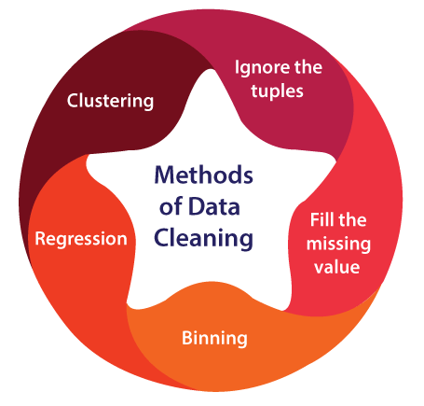
CLASS 30 CD-502 Data Pre-Processing UNIT 1
Techniques for Cleaning Data
Ignore the tuples
Fill in the missing value
Binning method
Regression
Clustering
Prof. Vineeta Shrivastava
Assistant Professor
Department of Computer Science & Engineering
LNCT-E, Bhopal
Lakshmi Narain College of Technology Excellence, Bhopal

Slide 42
CLASS 30 CD-502 Data Pre-Processing UNIT 1
Process of Data Cleaning
Monitoring the errors
Standardize the mining process
Validate data accuracy
Scrub for duplicate data
Research on data
Communicate with the team
Prof. Vineeta Shrivastava
Assistant Professor
Department of Computer Science & Engineering
LNCT-E, Bhopal
Lakshmi Narain College of Technology Excellence, Bhopal

Slide 43
CLASS 30 CD-502 Data Pre-Processing UNIT 1
Tools for Data Cleaning
Data Cleansing Tools can be very helpful if you are not confident of cleaning the data yourself or have no time to clean up all your data sets.
OpenRefine
Trifacta Wrangler
Prof. Vineeta Shrivastava
Assistant Professor
Department of Computer Science & Engineering
LNCT-E, Bhopal
Lakshmi Narain College of Technology Excellence, Bhopal

Slide 44
CLASS 30 CD-502 Data Pre-Processing UNIT 1
Drake
Data Ladder
Data Cleaner
Cloudingo
Reifier
IBM Infosphere Quality Stage
TIBCO Clarity
Winpure
Prof. Vineeta Shrivastava
Assistant Professor
Department of Computer Science & Engineering
LNCT-E, Bhopal
Lakshmi Narain College of Technology Excellence, Bhopal

Slide 45
CLASS 30 CD-502 Data Pre-Processing UNIT 1
Benefits of Data Cleaning
Removal of inaccuracies when several data sources are involved.
Clients are happier and employees are less annoyed when there are fewer mistakes.
The capacity to map out the many functions and the planned uses of your data.
Prof. Vineeta Shrivastava
Assistant Professor
Department of Computer Science & Engineering
LNCT-E, Bhopal
Lakshmi Narain College of Technology Excellence, Bhopal

Slide 46
CLASS 30 CD-502 Data Pre-Processing UNIT 1
Monitoring mistakes and improving reporting make it easier to resolve inaccurate or damaged data for future applications by allowing users to identify where issues are coming from.
Making decisions more quickly and with greater efficiency will be possible with the use of data cleansing tools.
Prof. Vineeta Shrivastava
Assistant Professor
Department of Computer Science & Engineering
LNCT-E, Bhopal
Lakshmi Narain College of Technology Excellence, Bhopal

Slide 47
CLASS 30 CD-502 Data Pre-Processing UNIT 1
AGENDA
Data Integration
What is data integration ?
Why it is important ?
Data integration approaches
Issues in Data Integration
Techniques used in Data Integration
Integration tools
Prof. Vineeta Shrivastava
Assistant Professor
Department of Computer Science & Engineering
LNCT-E, Bhopal
Lakshmi Narain College of Technology Excellence, Bhopal

Slide 48
CLASS 30 CD-502 Data Pre-Processing UNIT 1
Data Integration
Data integration is the process of merging data from several disparate sources.
While performing data integration, you must work on data redundancy, inconsistency, duplicity, etc.
Data integration is the process of combining data from many sources. Data integration must related with issues such as duplicated data, inconsistent data, old systems, etc.
Prof. Vineeta Shrivastava
Assistant Professor
Department of Computer Science & Engineering
LNCT-E, Bhopal
Lakshmi Narain College of Technology Excellence, Bhopal

Slide 49
CLASS 30 CD-502 Data Pre-Processing UNIT 1
Data integration is a record pre-processing method that includes merging data from a couple of the different data sources into coherent data to retain and provide a unified perspective of the data.
These assets could also include several record cubes, databases, or flat documents.
Prof. Vineeta Shrivastava
Assistant Professor
Department of Computer Science & Engineering
LNCT-E, Bhopal
Lakshmi Narain College of Technology Excellence, Bhopal

Slide 50
CLASS 30 CD-502 Data Pre-Processing UNIT 1
It has been an integral part of data operations because data can be obtained from several sources.
It is a strategy that integrates data from several sources to make it available to users in a single uniform view that shows their status.
Data fusion merges data from various diverse sources to produce meaningful results.
The consolidated findings must exclude inconsistencies, contradictions, redundancies, and inequities.
Prof. Vineeta Shrivastava
Assistant Professor
Department of Computer Science & Engineering
LNCT-E, Bhopal
Lakshmi Narain College of Technology Excellence, Bhopal

Slide 51
CLASS 30 CD-502 Data Pre-Processing UNIT 1
Why it is important ?
Data integration is important because it gives a uniform view of scattered data while also maintaining data accuracy.
It assists the data-mining program in meaningful mining information, which in turn assists the executive and managers make strategic decisions for the enterprise's benefit.
Prof. Vineeta Shrivastava
Assistant Professor
Department of Computer Science & Engineering
LNCT-E, Bhopal
Lakshmi Narain College of Technology Excellence, Bhopal

Slide 52
CLASS 30 CD-502 Data Pre-Processing UNIT 1
The data integration methods are formally characterized as a triple (G, S, M), where;
G represents the global schema,
S represents the heterogeneous source of schema,
M represents the mapping between source and global schema queries.
Prof. Vineeta Shrivastava
Assistant Professor
Department of Computer Science & Engineering
LNCT-E, Bhopal
Lakshmi Narain College of Technology Excellence, Bhopal

Slide 53
CLASS 30 CD-502 Data Pre-Processing UNIT 1
Data Integration Approaches
Tight Coupling
Loose Coupling
Tight Coupling
It is the process of using ETL (Extraction, Transformation, and Loading) to combine data from various sources into a single physical location.
Prof. Vineeta Shrivastava
Assistant Professor
Department of Computer Science & Engineering
LNCT-E, Bhopal
Lakshmi Narain College of Technology Excellence, Bhopal

Slide 54
CLASS 30 CD-502 Data Pre-Processing UNIT 1
Loose Coupling
Facts with loose coupling are most effectively kept in the actual source databases.
This approach provides an interface that gets a query from the user, changes it into a format that the supply database may understand, and then sends the query to the source databases without delay to obtain the result.
Prof. Vineeta Shrivastava
Assistant Professor
Department of Computer Science & Engineering
LNCT-E, Bhopal
Lakshmi Narain College of Technology Excellence, Bhopal

Slide 55
CLASS 30 CD-502 Data Pre-Processing UNIT 1
Issues in Data Integration
Entity Identification Problem
Redundancy and Correlation Analysis
Tuple Duplication
Data warfare Detection and backbone
Prof. Vineeta Shrivastava
Assistant Professor
Department of Computer Science & Engineering
LNCT-E, Bhopal
Lakshmi Narain College of Technology Excellence, Bhopal

Slide 56
CLASS 30 CD-502 Data Pre-Processing UNIT 1
Data Integration Techniques
Manual Integration
Middleware Integration
Application-based integration
Uniform Access Integration
Data Warehousing
Prof. Vineeta Shrivastava
Assistant Professor
Department of Computer Science & Engineering
LNCT-E, Bhopal
Lakshmi Narain College of Technology Excellence, Bhopal

Slide 57
CLASS 30 CD-502 Data Pre-Processing UNIT 1
Integration tools
On-promise data integration tool
Open-source data integration tool
Cloud-based data integration tool
Prof. Vineeta Shrivastava
Assistant Professor
Department of Computer Science & Engineering
LNCT-E, Bhopal
Lakshmi Narain College of Technology Excellence, Bhopal

Slide 58
CLASS 30 CD-502 Data Pre-Processing UNIT 1
AGENDA
Data Reduction
What is Data Reduction?
Why it is Important?
Techniques for Data Reduction
Benefits of Data Reduction
Prof. Vineeta Shrivastava
Assistant Professor
Department of Computer Science & Engineering
LNCT-E, Bhopal
Lakshmi Narain College of Technology Excellence, Bhopal

Slide 59
CLASS 30 CD-502 Data Pre-Processing UNIT 1
Data Reduction
Data reduction techniques ensure the integrity of data while reducing the data. Data reduction is a process that reduces the volume of original data and represents it in a much smaller volume.
Data reduction techniques are used to obtain a reduced representation of the dataset that is much smaller in volume by maintaining the integrity of the original data.
By reducing the data, the efficiency of the data analysis process is improved, which produces the same analytical results.
Prof. Vineeta Shrivastava
Assistant Professor
Department of Computer Science & Engineering
LNCT-E, Bhopal
Lakshmi Narain College of Technology Excellence, Bhopal

Slide 60
CLASS 30 CD-502 Data Pre-Processing UNIT 1
Importance of Data Reduction
Data reduction aims to define it more compactly. When the data size is smaller, it is simpler to apply sophisticated and computationally high-priced algorithms.
The reduction of the data may be in terms of the number of rows (records) or terms of the number of columns (dimensions).
Prof. Vineeta Shrivastava
Assistant Professor
Department of Computer Science & Engineering
LNCT-E, Bhopal
Lakshmi Narain College of Technology Excellence, Bhopal

Slide 61
CLASS 30 CD-502 Data Pre-Processing UNIT 1
Techniques of Data Reduction
Dimensionality Reduction
Numerosity Reduction
Data Cube Aggregation
Data Compression
Prof. Vineeta Shrivastava
Assistant Professor
Department of Computer Science & Engineering
LNCT-E, Bhopal
Lakshmi Narain College of Technology Excellence, Bhopal

Slide 62
CLASS 30 CD-502 Data Pre-Processing UNIT 1
1. Dimensionality Reduction
Dimensionality reduction eliminates the attributes from the data set under consideration, thereby reducing the volume of original data.
It reduces data size as it eliminates outdated or redundant features.
It is the process of reducing the number of attributes or random variables under consideration.
Prof. Vineeta Shrivastava
Assistant Professor
Department of Computer Science & Engineering
LNCT-E, Bhopal
Lakshmi Narain College of Technology Excellence, Bhopal

Slide 63
CLASS 30 CD-502 Data Pre-Processing UNIT 1
What is Dimensionality Reduction?
The number of input features, variables, or columns present in a given dataset is known as dimensionality, and the process to reduce these features is called dimensionality reduction.
Prof. Vineeta Shrivastava
Assistant Professor
Department of Computer Science & Engineering
LNCT-E, Bhopal
Lakshmi Narain College of Technology Excellence, Bhopal

Slide 64
CLASS 30 CD-502 Data Pre-Processing UNIT 1
Definition
Dimensionality reduction technique can be defined as, "It is a way of converting the higher dimensions dataset into lesser dimensions dataset ensuring that it provides similar information."
These techniques are widely used in machine learning for obtaining a better predictive model while solving the classification and regression problems.
Prof. Vineeta Shrivastava
Assistant Professor
Department of Computer Science & Engineering
LNCT-E, Bhopal
Lakshmi Narain College of Technology Excellence, Bhopal

Slide 65
CLASS 30 CD-502 Data Pre-Processing UNIT 1
It is commonly used in the fields that deal with high-dimensional data, such as speech recognition, signal processing, bioinformatics, etc.
It can also be used for data visualization, noise reduction, cluster analysis, etc.
Prof. Vineeta Shrivastava
Assistant Professor
Department of Computer Science & Engineering
LNCT-E, Bhopal
Lakshmi Narain College of Technology Excellence, Bhopal

Slide 66
CLASS 30 CD-502 Data Pre-Processing UNIT 1
Methods of Dimensionality Reduction
Feature Selection
Feature Extraction
Wavelet Transform
Attribute Subset Selection
Prof. Vineeta Shrivastava
Assistant Professor
Department of Computer Science & Engineering
LNCT-E, Bhopal
Lakshmi Narain College of Technology Excellence, Bhopal

Slide 67
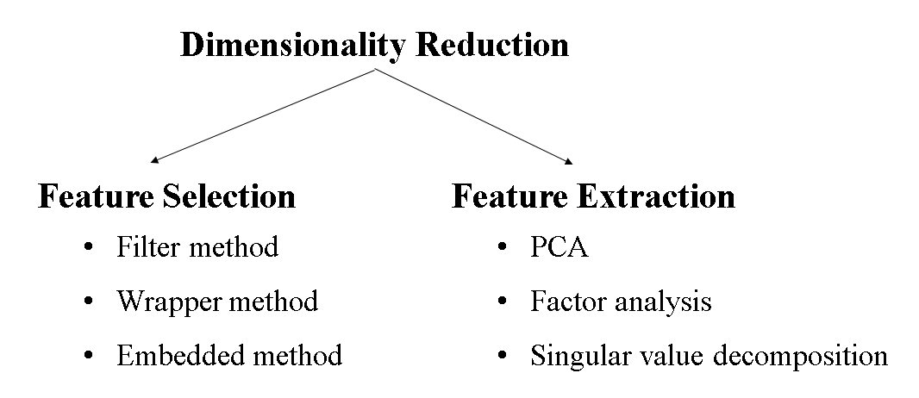
CLASS 30 CD-502 Data Pre-Processing UNIT 1
Prof. Vineeta Shrivastava
Assistant Professor
Department of Computer Science & Engineering
LNCT-E, Bhopal
Lakshmi Narain College of Technology Excellence, Bhopal

Slide 68

CLASS 30 CD-502 Data Pre-Processing UNIT 1
Principal Component Analysis (PCA)
Karl Pearson,1901
High dimensions $→$ Lower dimensions
Goal:- To reduce the dimensionality of a dataset while preserving most important patterns or relations between variables.
Prof. Vineeta Shrivastava
Assistant Professor
Department of Computer Science & Engineering
LNCT-E, Bhopal
Lakshmi Narain College of Technology Excellence, Bhopal

Slide 69
CLASS 30 CD-502 Data Pre-Processing UNIT 1
How Principal Component Analysis (PCA) Works ?
Principal Component Analysis (PCA) is used to reduce the dimensionality of a data set by finding a new set of variables, smaller than the original set of variables, retaining most of the sample’s information, and useful for the regression and classification of data.
Prof. Vineeta Shrivastava
Assistant Professor
Department of Computer Science & Engineering
LNCT-E, Bhopal
Lakshmi Narain College of Technology Excellence, Bhopal

Slide 70
CLASS 30 CD-502 Data Pre-Processing UNIT 1
Principal Component Analysis (PCA)
Suppose we have a data set to be analyzed that has tuples with n attributes. The principal component analysis identifies k independent features with n attributes that can represent the data set.
In this way, the original data can be converted into a much smaller space, and dimensionality reduction can be achieved.
Principal component analysis can be applied to sparse and skewed data.
Prof. Vineeta Shrivastava
Assistant Professor
Department of Computer Science & Engineering
LNCT-E, Bhopal
Lakshmi Narain College of Technology Excellence, Bhopal

Slide 71
CLASS 30 CD-502 Data Pre-Processing UNIT 1
Factor Analysis
Technique to reduce a large number of variables into fewer number of factors.
There will not be any outliers in the dataset.
Used to explore interactions between variables.
Singular value decomposition
SVD is like putting on special glasses that help us see the essential patterns in our data more clearly, making it easier to understand and work with.
SVD helps us simplify the data. It finds the most important patterns in the data and focuses on them, ignoring the less important stuff.
Prof. Vineeta Shrivastava
Assistant Professor
Department of Computer Science & Engineering
LNCT-E, Bhopal
Lakshmi Narain College of Technology Excellence, Bhopal

Slide 72
CLASS 30 CD-502 Data Pre-Processing UNIT 1
Wavelet Transform
In the wavelet transform, suppose a data vector A is transformed into a numerically different data vector A' such that both A and A' vectors are of the same length.
Then how it is useful in reducing data because the data obtained from the wavelet transform can be interrupted.
Wavelet transform can be applied to data cubes, sparse data, or skewed data.
Prof. Vineeta Shrivastava
Assistant Professor
Department of Computer Science & Engineering
LNCT-E, Bhopal
Lakshmi Narain College of Technology Excellence, Bhopal

Slide 73
CLASS 30 CD-502 Data Pre-Processing UNIT 1
Attribute Subset Selection
The large data set has many attributes, some of which are irrelevant and some are redundant.
The core attribute subset selection reduces the data volume and dimensionality.
The attribute subset selection reduces the volume of data by eliminating redundant and irrelevant attributes.
Prof. Vineeta Shrivastava
Assistant Professor
Department of Computer Science & Engineering
LNCT-E, Bhopal
Lakshmi Narain College of Technology Excellence, Bhopal

Slide 74
CLASS 30 CD-502 Data Pre-Processing UNIT 1
The attribute subset selection ensures that we get a good subset of original attributes even after eliminating the unwanted attributes.
The resulting probability of data distribution is as close as possible to the original data distribution using all the attributes.
Prof. Vineeta Shrivastava
Assistant Professor
Department of Computer Science & Engineering
LNCT-E, Bhopal
Lakshmi Narain College of Technology Excellence, Bhopal

Slide 75
CLASS 30 CD-502 Data Pre-Processing UNIT 1
2. Numerosity Reduction
The numerosity reduction reduces the original data volume and represents it in a much smaller form.
It reduces the data volume by choosing alternative smaller forms of data representation.
Types of numerosity reduction
Parametric numerosity reduction.
Non-parametric numerosity reduction.
Prof. Vineeta Shrivastava
Assistant Professor
Department of Computer Science & Engineering
LNCT-E, Bhopal
Lakshmi Narain College of Technology Excellence, Bhopal

Slide 76
CLASS 30 CD-502 Data Pre-Processing UNIT 1
Parametric: Parametric numerosity reduction incorporates storing only data parameters instead of the original data.
Only parameters of data and outliers are stored instead of actual data.
Regression and Log-Linear
Prof. Vineeta Shrivastava
Assistant Professor
Department of Computer Science & Engineering
LNCT-E, Bhopal
Lakshmi Narain College of Technology Excellence, Bhopal

Slide 77
CLASS 30 CD-502 Data Pre-Processing UNIT 1
Non-Parametric: A non-parametric numerosity reduction technique does not assume any model.
The non-Parametric technique results in a more uniform reduction, irrespective of data size, but it may not achieve a high volume of data reduction like the parametric.
Histogram
Clustering
Sampling
Prof. Vineeta Shrivastava
Assistant Professor
Department of Computer Science & Engineering
LNCT-E, Bhopal
Lakshmi Narain College of Technology Excellence, Bhopal

Slide 78
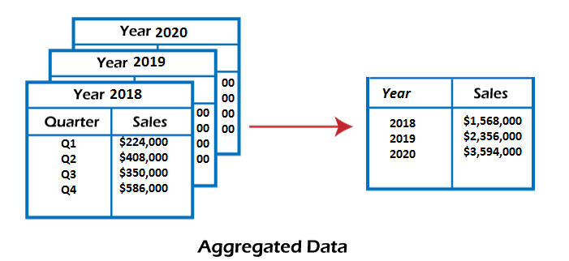
CLASS 30 CD-502 Data Pre-Processing UNIT 1
Data Cube Aggregation
This technique is used to aggregate data in a simpler form.
Data Cube Aggregation is a multidimensional aggregation that uses aggregation at various levels of a data cube to represent the original data set, thus achieving data reduction.
Prof. Vineeta Shrivastava
Assistant Professor
Department of Computer Science & Engineering
LNCT-E, Bhopal
Lakshmi Narain College of Technology Excellence, Bhopal

Slide 79
CLASS 30 CD-502 Data Pre-Processing UNIT 1
The data cube aggregation is a multidimensional aggregation that eases multidimensional analysis.
The data cube present precomputed and summarized data which eases the data mining into fast access.
Prof. Vineeta Shrivastava
Assistant Professor
Department of Computer Science & Engineering
LNCT-E, Bhopal
Lakshmi Narain College of Technology Excellence, Bhopal

Slide 80
CLASS 30 CD-502 Data Pre-Processing UNIT 1
Data Compression
Data compression employs modification, encoding, or converting the structure of data in a way that consumes less space.
Data compression involves building a compact representation of information by removing redundancy and representing data in binary form.
Prof. Vineeta Shrivastava
Assistant Professor
Department of Computer Science & Engineering
LNCT-E, Bhopal
Lakshmi Narain College of Technology Excellence, Bhopal

Slide 81
CLASS 30 CD-502 Data Pre-Processing UNIT 1
Data that can be restored successfully from its compressed form is called Lossless compression.
In contrast, the opposite where it is not possible to restore the original form from the compressed form is Lossy compression. Dimensionality and numerosity reduction method are also used for data compression.
Prof. Vineeta Shrivastava
Assistant Professor
Department of Computer Science & Engineering
LNCT-E, Bhopal
Lakshmi Narain College of Technology Excellence, Bhopal

Slide 82
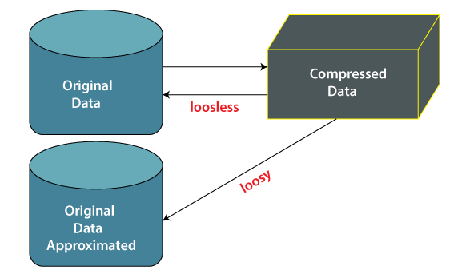
CLASS 30 CD-502 Data Pre-Processing UNIT 1
Prof. Vineeta Shrivastava
Assistant Professor
Department of Computer Science & Engineering
LNCT-E, Bhopal
Lakshmi Narain College of Technology Excellence, Bhopal

Slide 83
CLASS 30 CD-502 Data Pre-Processing UNIT 1
Data compression techniques
Lossless Compression
Lossy Compression
Prof. Vineeta Shrivastava
Assistant Professor
Department of Computer Science & Engineering
LNCT-E, Bhopal
Lakshmi Narain College of Technology Excellence, Bhopal

Slide 84
CLASS 30 CD-502 Data Pre-Processing UNIT 1
Lossless Compression
Encoding techniques (Run Length Encoding) allow a simple and minimal data size reduction.
Lossless data compression uses algorithms to restore the precise original data from the compressed data.
Prof. Vineeta Shrivastava
Assistant Professor
Department of Computer Science & Engineering
LNCT-E, Bhopal
Lakshmi Narain College of Technology Excellence, Bhopal

Slide 85
CLASS 30 CD-502 Data Pre-Processing UNIT 1
Lossy Compression
In lossy-data compression, the decompressed data may differ from the original data but are useful enough to retrieve information from them.
For example, the JPEG image format is a lossy compression, but we can find the meaning equivalent to the original image.
Methods such as the Discrete Wavelet transform technique PCA (principal component analysis) are examples of this compression.
Prof. Vineeta Shrivastava
Assistant Professor
Department of Computer Science & Engineering
LNCT-E, Bhopal
Lakshmi Narain College of Technology Excellence, Bhopal

Slide 86
CLASS 30 CD-502 Data Pre-Processing UNIT 1
Benefits of Data Reduction
Data reduction can save energy.
Data reduction can reduce your physical storage costs.
And data reduction can decrease your data center track
Prof. Vineeta Shrivastava
Assistant Professor
Department of Computer Science & Engineering
LNCT-E, Bhopal
Lakshmi Narain College of Technology Excellence, Bhopal

Slide 87
CLASS 30 CD-502 Data Pre-Processing UNIT 1
AGENDA
Data Transformation
What is Data Transformation?
Why it is Important?
Techniques for Data Transformation
Process of Data Transformation
Advantage and Disadvantages
Tools used
Prof. Vineeta Shrivastava
Assistant Professor
Department of Computer Science & Engineering
LNCT-E, Bhopal
Lakshmi Narain College of Technology Excellence, Bhopal

Slide 88
CLASS 30 CD-502 Data Pre-Processing UNIT 1
Data Transformation
Data transformation is a technique used to convert the raw data into a suitable format that efficiently eases data analysis and retrieves strategic information.
Data transformation includes data cleaning techniques and a data reduction technique to convert the data into the appropriate form.
Prof. Vineeta Shrivastava
Assistant Professor
Department of Computer Science & Engineering
LNCT-E, Bhopal
Lakshmi Narain College of Technology Excellence, Bhopal

Slide 89
CLASS 30 CD-502 Data Pre-Processing UNIT 1
Data Transformation
Data transformation is an essential data pre-processing technique that must be performed on the data before data analysis to provide patterns that are easier to understand.
Prof. Vineeta Shrivastava
Assistant Professor
Department of Computer Science & Engineering
LNCT-E, Bhopal
Lakshmi Narain College of Technology Excellence, Bhopal

Slide 90
CLASS 30 CD-502 Data Pre-Processing UNIT 1
Data transformation changes the format, structure, or values of the data and converts them into clean, usable data.
Data may be transformed at two stages of the data pipeline for data analytics projects. Organizations that use on-premises data warehouses generally use an ETL (extract, transform, and load) process, in which data transformation is the middle step.
The scalability of the cloud platform lets organizations skip preload transformations and load raw data into the data warehouse, then transform it at query time.
Prof. Vineeta Shrivastava
Assistant Professor
Department of Computer Science & Engineering
LNCT-E, Bhopal
Lakshmi Narain College of Technology Excellence, Bhopal

Slide 91
CLASS 30 CD-502 Data Pre-Processing UNIT 1
Importance
Data integration, migration, data warehousing, data wrangling may all involve data transformation.
Data transformation increases the efficiency of business and analytic processes, and it enables businesses to make better data-driven decisions.
During the data transformation process, an analyst will determine the structure of the data.
Prof. Vineeta Shrivastava
Assistant Professor
Department of Computer Science & Engineering
LNCT-E, Bhopal
Lakshmi Narain College of Technology Excellence, Bhopal

Slide 92
CLASS 30 CD-502 Data Pre-Processing UNIT 1
Data transformation may be:-
Constructive: The data transformation process adds, copies, or replicates data.
Destructive: The system deletes fields or records.
Aesthetic: The transformation standardizes the data to meet requirements or parameters.
Structural: The database is reorganized by renaming, moving, or combining columns.
Prof. Vineeta Shrivastava
Assistant Professor
Department of Computer Science & Engineering
LNCT-E, Bhopal
Lakshmi Narain College of Technology Excellence, Bhopal

Slide 93
CLASS 30 CD-502 Data Pre-Processing UNIT 1
Data Transformation Techniques
Data Smoothing
Data Normalization
Data Discretization
Data Generalization
Prof. Vineeta Shrivastava
Assistant Professor
Department of Computer Science & Engineering
LNCT-E, Bhopal
Lakshmi Narain College of Technology Excellence, Bhopal

Slide 94
CLASS 30 CD-502 Data Pre-Processing UNIT 1
Data Smoothing
The concept behind data smoothing is that it will be able to identify simple changes to help predict different trends and patterns.
This serves as a help to analysts or traders who need to look at a lot of data which can often be difficult to digest for finding patterns that they wouldn't see otherwise.
Techniques to Remove Noise.
Binning
Regression
Clustering
Prof. Vineeta Shrivastava
Assistant Professor
Department of Computer Science & Engineering
LNCT-E, Bhopal
Lakshmi Narain College of Technology Excellence, Bhopal

Slide 95
CLASS 30 CD-502 Data Pre-Processing UNIT 1
2. Data Normalization
Normalizing the data refers to scaling the data values to a much smaller range such as [-1, 1] or [0.0, 1.0].
Methods to normalize the data
Min-max normalization
Z-score normalization
Decimal Scaling
Prof. Vineeta Shrivastava
Assistant Professor
Department of Computer Science & Engineering
LNCT-E, Bhopal
Lakshmi Narain College of Technology Excellence, Bhopal

Slide 96
CLASS 30 CD-502 Data Pre-Processing UNIT 1
3. Data Discretization
This is a process of converting continuous data into a set of data intervals.
Continuous attribute values are substituted by small interval labels.
This makes the data easier to study and analyse.
If a data analysis task handles a continuous attribute, then its discrete values can be replaced by constant quality attributes.
This improves the efficiency of the task.
Prof. Vineeta Shrivastava
Assistant Professor
Department of Computer Science & Engineering
LNCT-E, Bhopal
Lakshmi Narain College of Technology Excellence, Bhopal

Slide 97
CLASS 30 CD-502 Data Pre-Processing UNIT 1
This method is also called a data reduction mechanism as it transforms a large dataset into a set of categorical data.
Discretization also uses decision tree-based algorithms to produce short, compact, and accurate results when using discrete values.
Prof. Vineeta Shrivastava
Assistant Professor
Department of Computer Science & Engineering
LNCT-E, Bhopal
Lakshmi Narain College of Technology Excellence, Bhopal

Slide 98
CLASS 30 CD-502 Data Pre-Processing UNIT 1
Data discretization can be classified into four types:
Splitting
Merging
Supervised discretization
Unsupervised discretization
For example, the values for the age attribute can be replaced by the interval labels such as (0-10, 11-20…) or (kid, youth, adult, senior).
Prof. Vineeta Shrivastava
Assistant Professor
Department of Computer Science & Engineering
LNCT-E, Bhopal
Lakshmi Narain College of Technology Excellence, Bhopal

Slide 99
CLASS 30 CD-502 Data Pre-Processing UNIT 1
4. Data Generalization
It converts low-level data attributes to high-level data attributes using concept hierarchy.
This conversion from a lower level to a higher conceptual level is useful to get a clearer picture of the data.
Prof. Vineeta Shrivastava
Assistant Professor
Department of Computer Science & Engineering
LNCT-E, Bhopal
Lakshmi Narain College of Technology Excellence, Bhopal

Slide 100
CLASS 30 CD-502 Data Pre-Processing UNIT 1
Data generalization can be divided into two approaches:
Data cube process (OLAP) approach.
Attribute-oriented induction (AOI) approach.
For example, age data can be in the form of (20, 30) in a dataset. It is transformed into a higher conceptual level into a categorical value (young, old).
Prof. Vineeta Shrivastava
Assistant Professor
Department of Computer Science & Engineering
LNCT-E, Bhopal
Lakshmi Narain College of Technology Excellence, Bhopal

Slide 101
CLASS 30 CD-502 Data Pre-Processing UNIT 1
Data Transformation Process
The entire process for transforming data is known as ETL (Extract, Load, and Transform).
Through the ETL process, analysts can convert data to its desired format.
Data Discovery
Data Mapping
Data Extraction
Code Generation and Execution
Review
Sending
Prof. Vineeta Shrivastava
Assistant Professor
Department of Computer Science & Engineering
LNCT-E, Bhopal
Lakshmi Narain College of Technology Excellence, Bhopal

Slide 102
CLASS 30 CD-502 Data Pre-Processing UNIT 1
Advantages of Data Transformation
Better Organization
Improved Data Quality
Perform Faster Queries
Better Data Management
More Use Out of Data
Prof. Vineeta Shrivastava
Assistant Professor
Department of Computer Science & Engineering
LNCT-E, Bhopal
Lakshmi Narain College of Technology Excellence, Bhopal

Slide 103
CLASS 30 CD-502 Data Pre-Processing UNIT 1
Disadvantages of Data Transformation
Data transformation can be expensive.
Data transformation processes can be resource-intensive.
Lack of expertise and carelessness can introduce problems during transformation.
Enterprises can perform transformations that don't suit their needs.
Prof. Vineeta Shrivastava
Assistant Professor
Department of Computer Science & Engineering
LNCT-E, Bhopal
Lakshmi Narain College of Technology Excellence, Bhopal

Slide 104
CLASS 30 CD-502 Data Pre-Processing UNIT 1
Tools
Scripting
On-Premises ETL Tools
Cloud-Based ETL Tools
Prof. Vineeta Shrivastava
Assistant Professor
Department of Computer Science & Engineering
LNCT-E, Bhopal
Lakshmi Narain College of Technology Excellence, Bhopal

Slide 105
CLASS 30 CD-502 Data Pre-Processing UNIT 1
Normalizing dataset
Normalizing a dataset is a common preprocessing step in machine learning and data analysis. It ensures that features within the dataset are on a similar scale, which can improve the performance of various algorithms.
Prof. Vineeta Shrivastava
Assistant Professor
Department of Computer Science & Engineering
LNCT-E, Bhopal
Lakshmi Narain College of Technology Excellence, Bhopal

Slide 106
CLASS 30 CD-502 Data Pre-Processing UNIT 1
Normalization involves rescaling the values of features to a standard range, typically between 0 and 1, or -1 and 1. The goal is to ensure that no feature dominates others due to its scale, which can be crucial for distance-based algorithms like k-nearest neighbors or gradient-based methods like neural networks
Prof. Vineeta Shrivastava
Assistant Professor
Department of Computer Science & Engineering
LNCT-E, Bhopal
Lakshmi Narain College of Technology Excellence, Bhopal

Slide 107

CLASS 30 CD-502 Data Pre-Processing UNIT 1
Common Normalization Techniques:
1. Min-Max Scaling:
This scales the data to a fixed range [0, 1]
$$X_{norm}=\frac{X−X_{min}}{X_{max}−X_{min}}$$
Prof. Vineeta Shrivastava
Assistant Professor
Department of Computer Science & Engineering
LNCT-E, Bhopal
Lakshmi Narain College of Technology Excellence, Bhopal

Slide 108

CLASS 30 CD-502 Data Pre-Processing UNIT 1
2. Z-Score Standardization (Standardization):
$$X_{norm}=\frac{X−μ}{σ}$$
Here, μ is the mean of the feature and σ is the standard deviation. This centers the data around 0 with a standard deviation of 1.
Prof. Vineeta Shrivastava
Assistant Professor
Department of Computer Science & Engineering
LNCT-E, Bhopal
Lakshmi Narain College of Technology Excellence, Bhopal

Slide 109

CLASS 30 CD-502 Data Pre-Processing UNIT 1
3. Max Absolute Scaling:
$$X_{norm}=\frac{X}{X_{max}}$$
This scales each feature by its maximum absolute value, preserving the sign of the data.
Prof. Vineeta Shrivastava
Assistant Professor
Department of Computer Science & Engineering
LNCT-E, Bhopal
Lakshmi Narain College of Technology Excellence, Bhopal

Slide 110

CLASS 30 CD-502 Data Pre-Processing UNIT 1
4. Robust Scaling:
$$X_{norm}=\frac{X−{median}_{X}}{{IQR}_{X}}$$
This method is useful when dealing with outliers. The data is centered using the median and scaled using the interquartile range (IQR).
Prof. Vineeta Shrivastava
Assistant Professor
Department of Computer Science & Engineering
LNCT-E, Bhopal
Lakshmi Narain College of Technology Excellence, Bhopal

Slide 111
CLASS 30 CD-502 Data Pre-Processing UNIT 1
4. Choosing the Right Technique:
Min-Max Scaling: Use when you know the data’s boundaries or want to keep the data within a specific range.
Standardization: Best for data that follows a Gaussian distribution. Many machine learning algorithms assume standardized data.
Max Absolute Scaling: Good when you have data with varying magnitudes but you want to preserve the sign.
Robust Scaling: Effective when the dataset contains outliers.
Prof. Vineeta Shrivastava
Assistant Professor
Department of Computer Science & Engineering
LNCT-E, Bhopal
Lakshmi Narain College of Technology Excellence, Bhopal

Slide 112
CLASS 30 CD-502 Data Pre-Processing UNIT 1
THANKYOU
Prof. Vineeta Shrivastava
Assistant Professor
Department of Computer Science & Engineering
LNCT-E, Bhopal
Lakshmi Narain College of Technology Excellence, Bhopal

